Slide 1
Introduction to mixed eﬀects modeling using R
Naomi Havron
(Slides based on Alex Fine’s Introduction to LMEMs in R)

Slide 2
Review – Linear regressions
Regression answers the following question:
How do I identify the parameters of a curve that relates X to Y in a way that minimizes, on average, how wrong I am about the data?
Other words – we want to be able to say, if you give us the value of a mother’s IQ score, what would be her child’s IQ

Slide 3
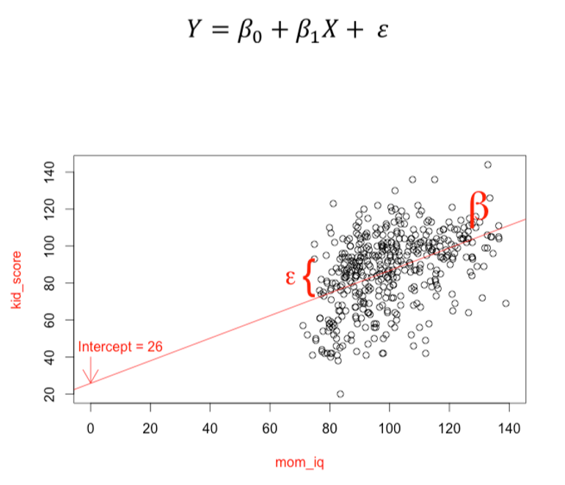
Review – Linear regressions

Slide 4
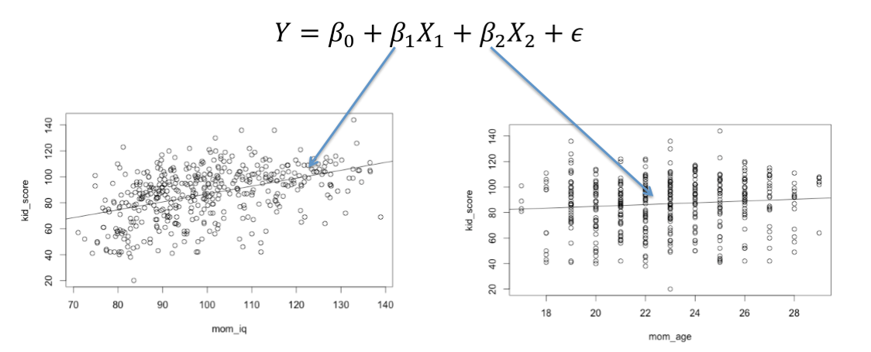
Allow us to compare the strength of different variables

Slide 5
But there will be times when linear regressions will be inadequate
When observations are grouped in some interesting way (e.g. clients of the same social worker).
When we are interested, at the same time, in between-subject and within-subject parameters (e.g., frequency and age).

Slide 6
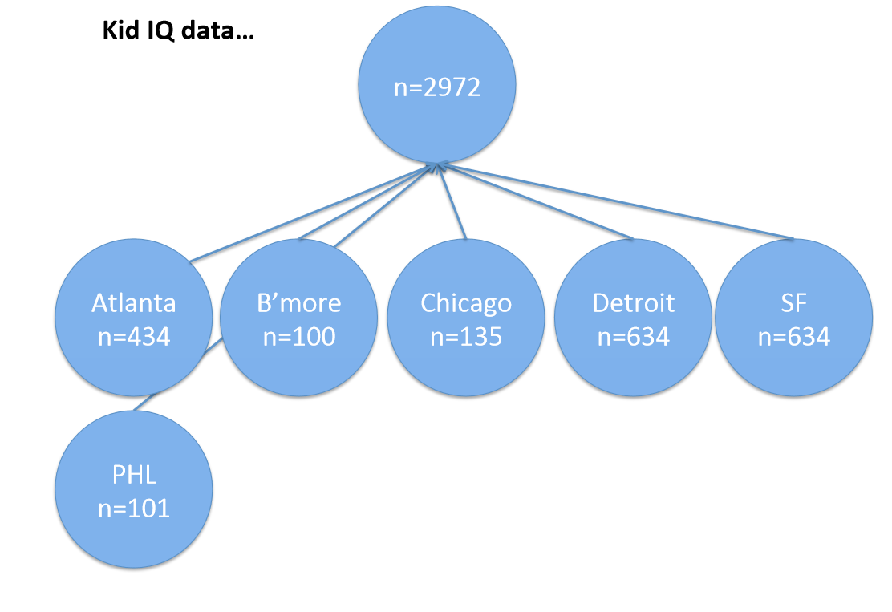

Slide 7
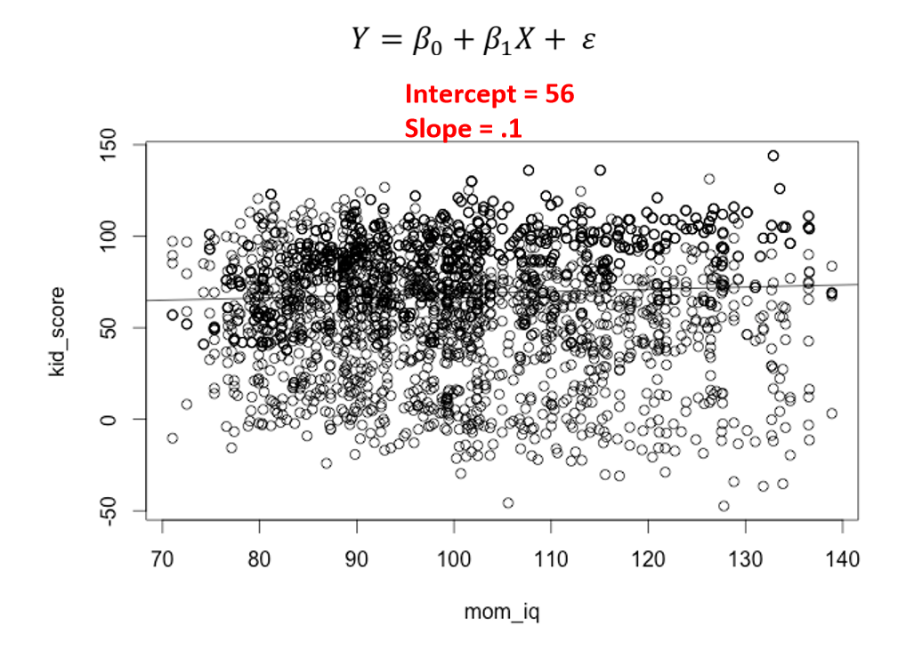

Slide 8
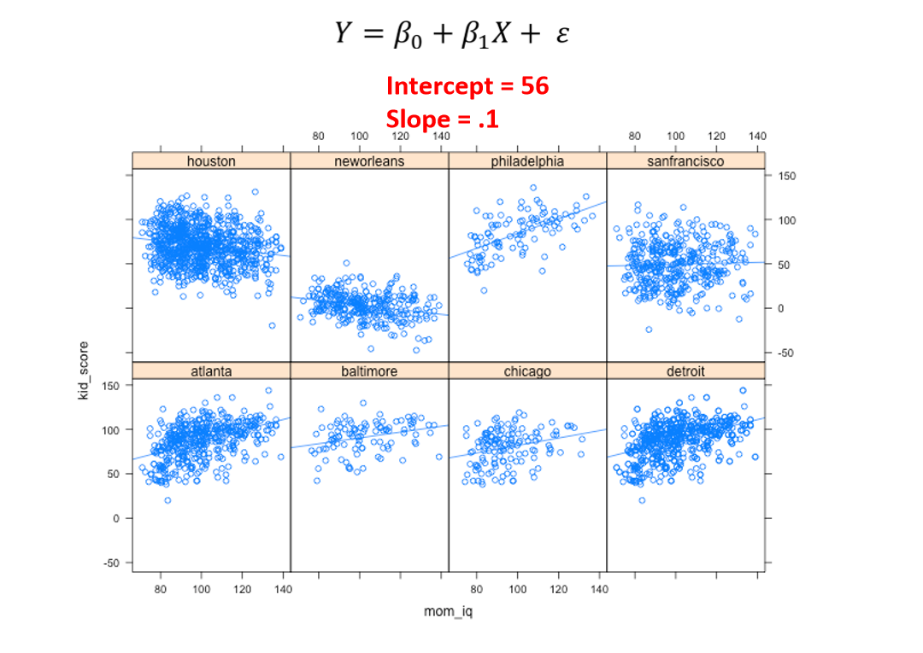

Slide 9
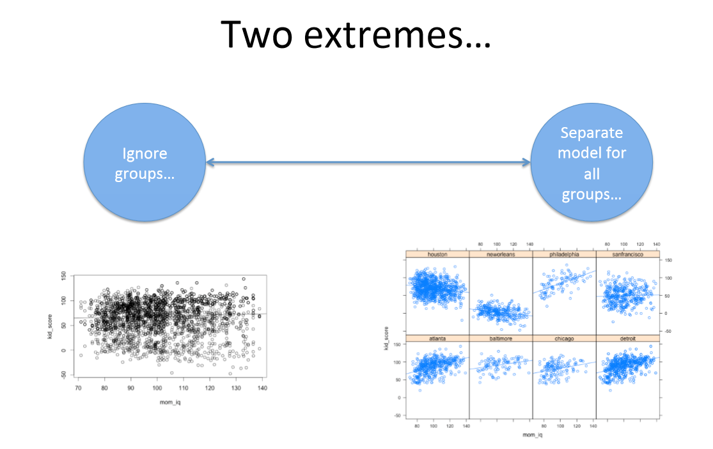

Slide 10
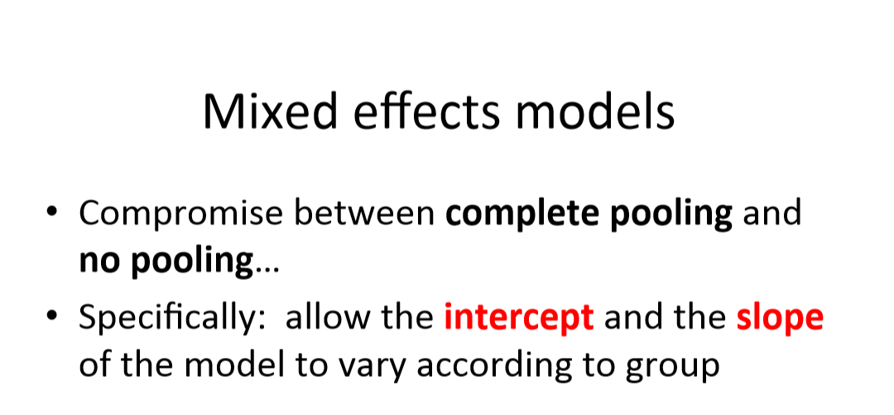

Slide 11
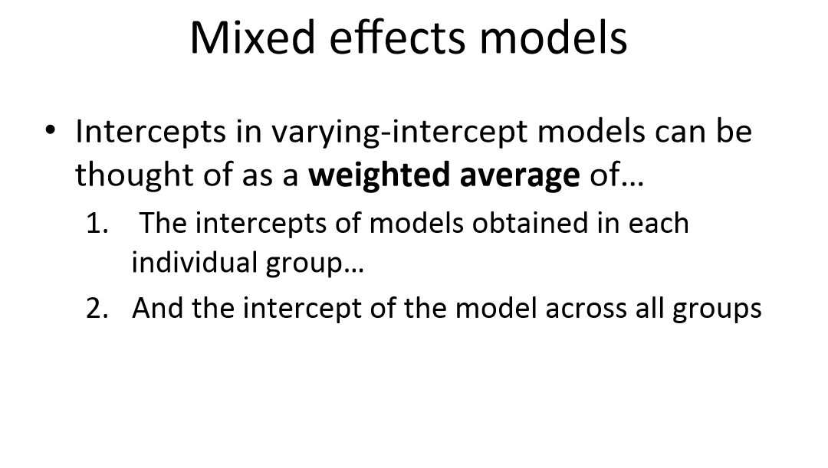

Slide 13
#Go to code

Slide 14
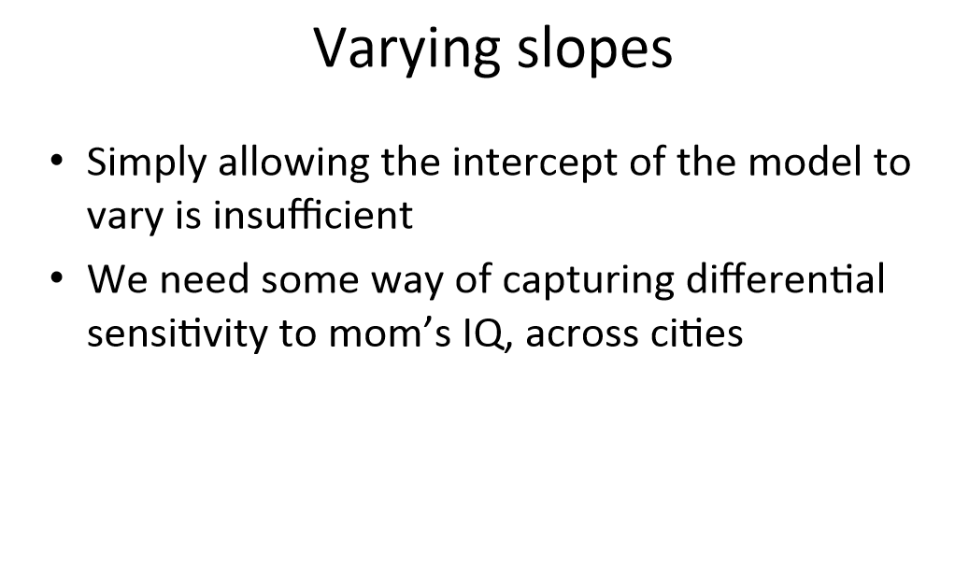

Slide 15
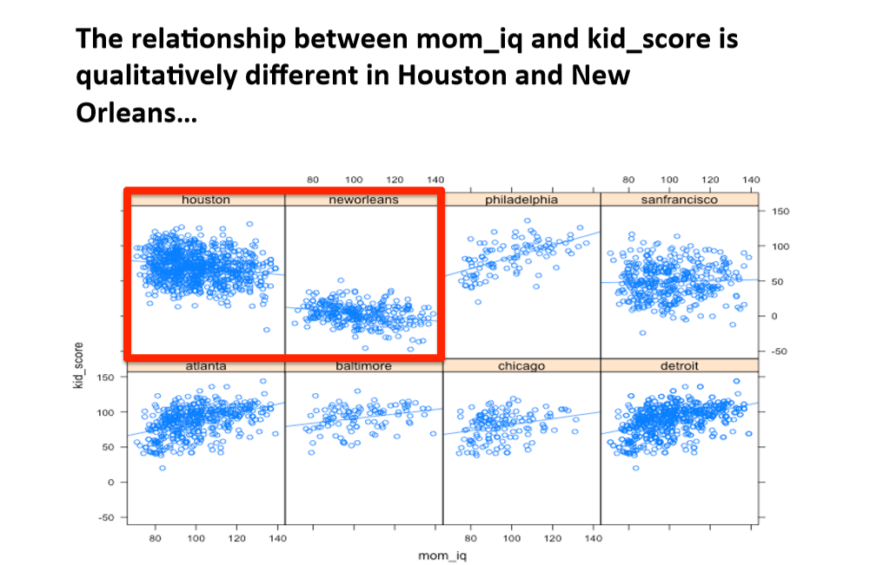

Slide 16
Are our effects robust to differences between cities? Will they generalize?

Slide 17
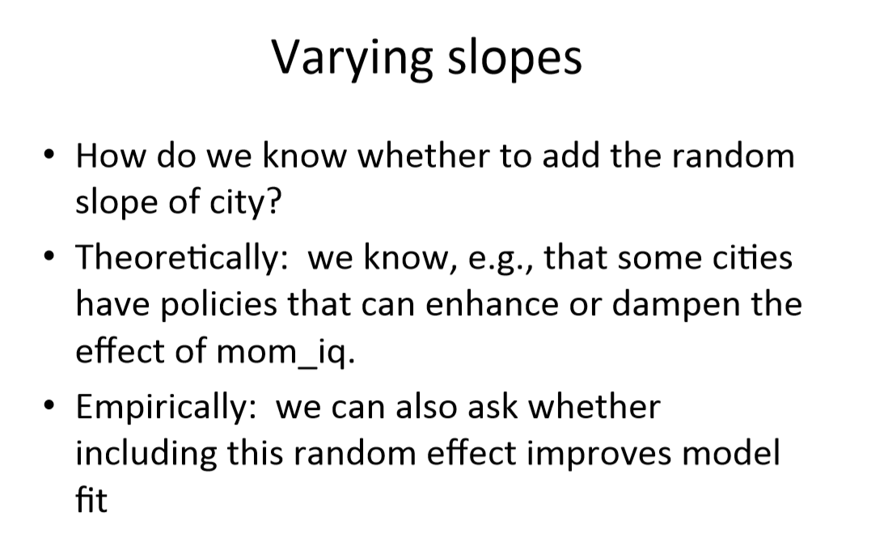

Slide 18
#Go to code

Slide 19
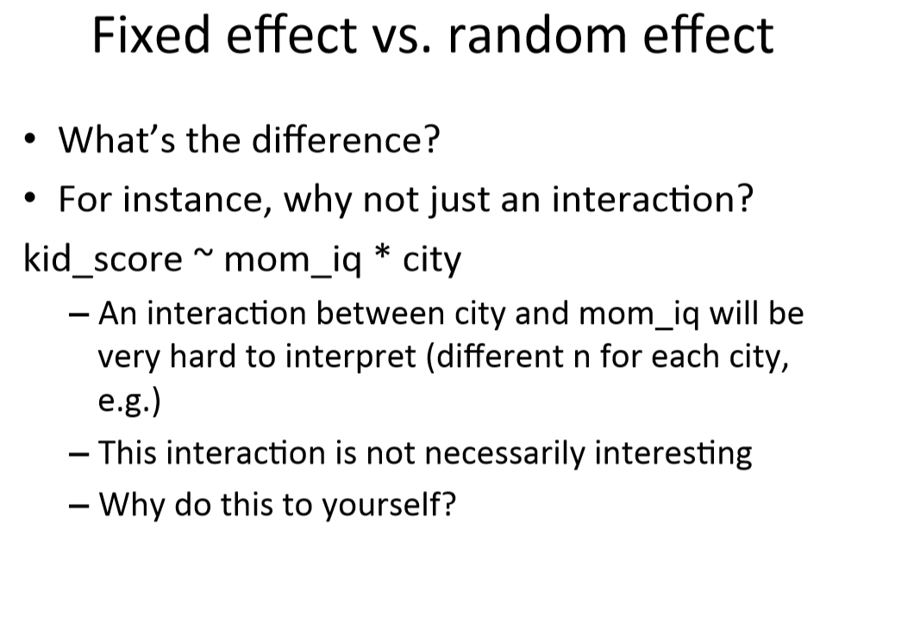

Slide 20
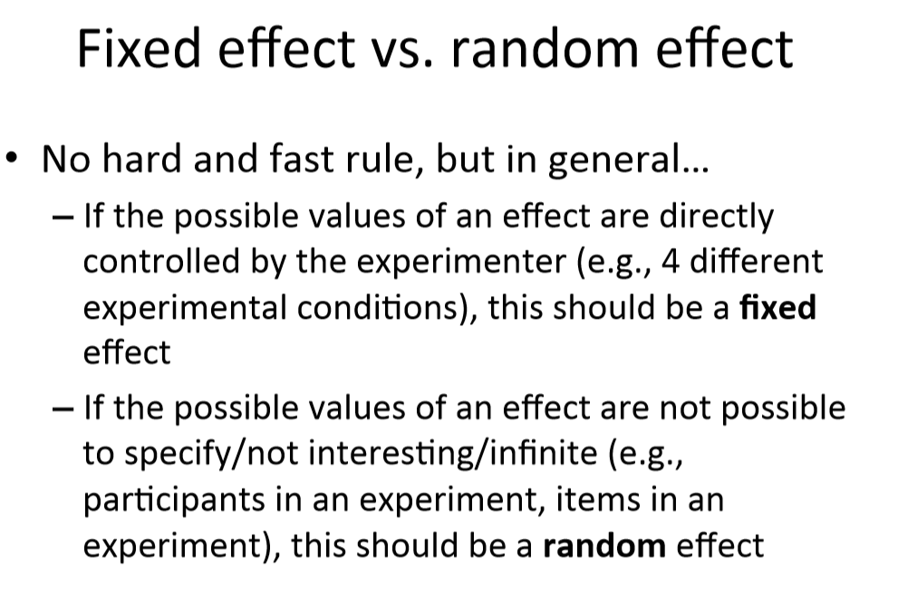

Slide 21
How do I determine my random-effects structure?
Decisions can be based on:
Data – some people do this and there is arguments in the literature, I was taught not to do this
Design – every factor that is of theoretical significance and can logically be a slope goes in!

Slide 22
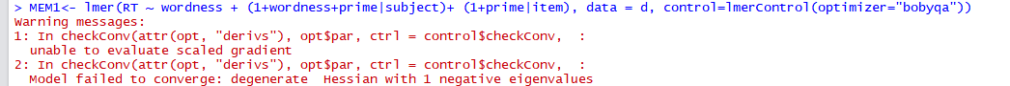
How do I determine my random-effects structure?
Design – every factor that is on theoretical significance
"but now my model doesn't converge!“

Slide 23
How do I determine my random-effects structure?
Design – every factor that is on theoretical significance
"but now my model doesn't converge!“
Start by removing factors that are less important theoretically
Remove items associated with lower variance
you can remove an intercept without removing the slopes: (0+factor|item)
You can remove main effects and leave interaction: (1+factor_1:factor_2|item)

Slide 24
#Go to code

Slide 25
Coding categorical data
We will focus on the main two coding schemes:
Dummy coding
Sum coding

Slide 26
Coding schemes
Dummy coding: One group is the reference group, the other is compared to it.
Sum coding: We compare to the grand mean.

Slide 27
#Go to code

Slide 28
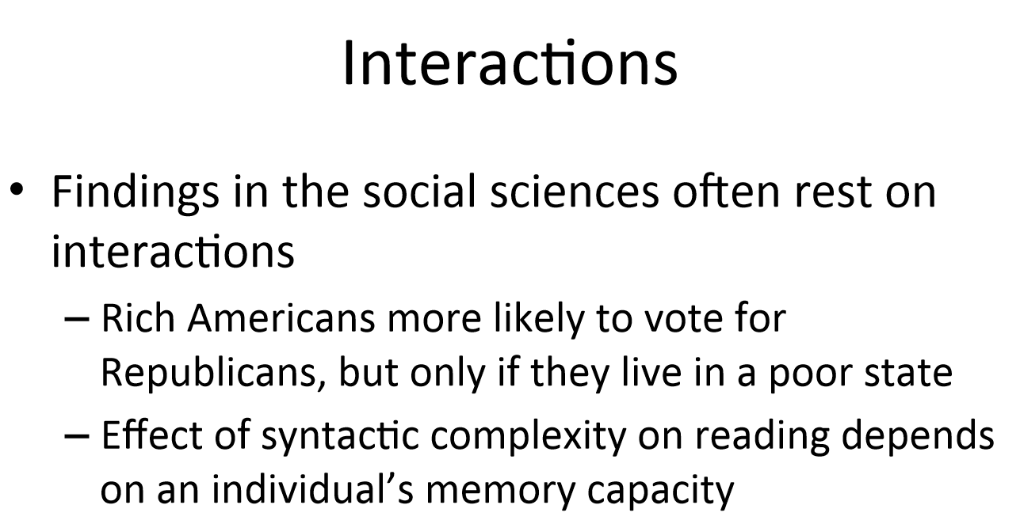

Slide 29
Specifying an interaction:
Factor_1*Factor_2
Interaction + main effects
Factor_1:Factor_2
Interaction only

Slide 30
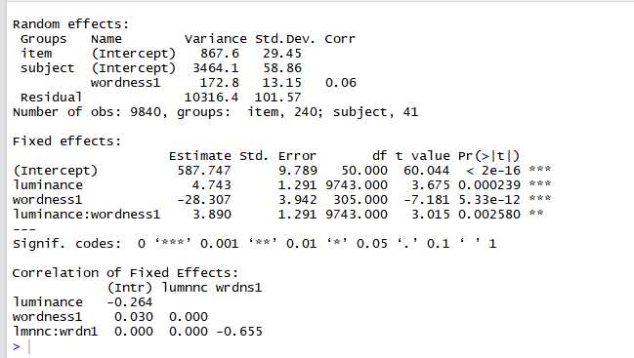
Output for the interaction

Slide 31
Output for the interaction

Slide 32
Output for the interaction

Slide 33
Which way does my interaction go?
Look for the sign (+/-) – not enough
Simple slopes test
Graph it…
How to do model comparisons with interaction?

Slide 34
#Go to code

Slide 35
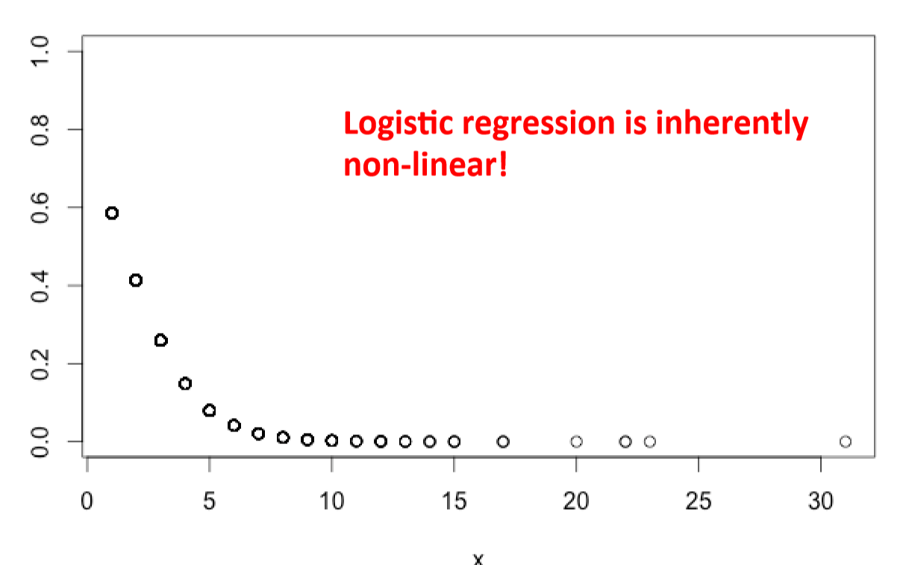
Logistic regressions
How do changes in the independent variables affect the probability of the outcome measure (in logit space).
To go back to probabilities you can use the function inv.logit()but beware that:

